Slide 1
Advanced Files: CSVs and Modules
Week 6 | Lecture 2 (6.2.2)
While waiting for class to start:
Download and open the Jupyter Notebook (.ipynb) for Lecture 6.2.2
You should NOT use JupyterHub for this lecture
Upcoming:
Reflection 6 released Friday @ 11 AM
Lab 5 due this Friday
Behrang’s Coffee Break / Office Hours Friday @ 1 PM
PRA (Lab) on Friday @ 2PM this week
Exam Review – Friday June 21 (Is online preferred?)

Slide 2
This Week’s Content
Lecture 11.1
More OOP! Encapsulation and Examples
Lecture 11.2
Advanced Files: CSVs and Modules
Lecture 11.3 - Cancelled
Sleeping at home

Slide 3

The ”Writing to Files” Recipe
# open/create a file
myfile = open("grades.txt", "w")
# write to a file
myfile.write(’string’)
# close the file
myfile.close()
go together

Slide 4
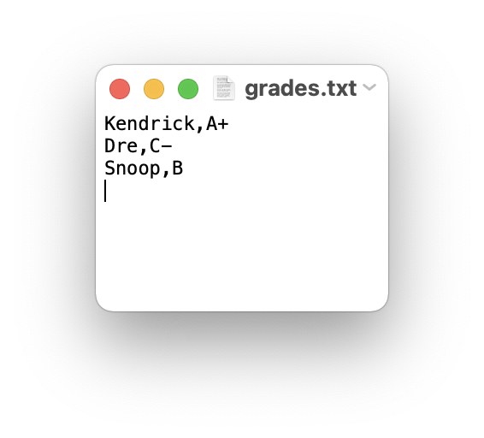
Example: Writing to Files
How would we store a dictionary data structure in a file?
students = {‘Kendrick': 'A+', ‘Dre': 'C-', ‘Snoop': 'B'}
# create a file
myfile = open("grades.txt", "w")
# store dictionary items to the file
for student in students:
myfile.write(student + ',' + students[student] + '\n')
# close the file
myfile.close()

Slide 5
Let’s Code!
Let’s take a look at how this works in Python!
Using a loop to write a dictionary to file
Open your notebook
Click Link:
1. Writing a dictionary to file

Slide 6
Different ways of Reading a File
Reading a file is similar to writing a file. First we need to open a file for reading (“r”):
If file doesn’t exist? ERROR
Then to read a file we apply one of the following approaches which take advantage of various read methods:
The read approach
The readline approach
The for line in file approach
The readlines approach
myfile = open(‘test.txt’, ‘r’)
No correct approach!
Multiple methods to help with contexts and purposes

Slide 7
Different ways of Reading a File
Approach | Code | When to use it
The read approach | myfile = open(filename, 'r') contents = myfile.read() myfile.close() | When you want to read the whole file at once and use it as a single string.
The readline approach | myfile = open(filename, 'r') contents = '' line = myfile.readline() while line != '': contents += line line = myfile.readline() myfile.close() | When you want to process only part of a file. Each time through the loop line contains one line of the file.
The for line in file approach | myfile = open(filename, 'r') contents = '' for line in myfile: contents += line myfile.close() | When you want to process every line in the file one at a time.
The readlines approach | myfile = open(filename, 'r') lines = myfile.readlines() myfile.close() | When you want to examine each line of a file by index.
WEEK 3
TODAY

Slide 8
Example: Reading a File
Now that we have a file "grades.txt" stored. How would we go about retrieving and storing the data into a dictionary?
students = {}
myfile = open("grades.txt", "r")
# read each line of the file
for line in myfile:
# find indices for slicing each line
ind1 = line.find(',')
ind2 = line.find('\\')
name = line[:ind1]
grade = line[ind1+1:ind2]
students[name] = grade
myfile.close()
grades.txt
Kendrick,A+
Dre,C-
Snoop,B
>>> students
{‘Kendrick’: A+, ‘Dre': 'C-', ‘Snoop': ‘B'}

Slide 9
Let’s Code!
Let’s take a look at how this works in Python!
Different read approaches
read()
readline()
for line in file
readlines()
Open your notebook
Click Link:
2. More advanced file reading

Slide 10
The with Statement
Every call on function open should have an accompanying call on the method close.
Python provides a statement with, which automatically closes the file when the end of with block is reached.
The general form of a with statement is as follows:
with open(filename, mode) as variable:
body

Slide 11
Example: with Statement
Modifying the previous example, of reading a file into a dictionary, to use the with statement.
students = {}
myfile = open("grades.txt", "r")
with open("grades.txt", "r") as myfile:
# read each line of the file
for line in myfile:
ind1 = line.find(',')
ind2 = line.find('\\')
name = line[:ind1]
grade = line[ind1+1:ind2]
students[name] = grade
myfile.close()

Slide 12
Let’s Code!
Let’s take a look at how this works in Python!
Opening and closing files with the with statement
Beakout Session!
Click Link:
3. The with statement

Slide 13


Comma Separated Values files
We use them often in Excel, and other spreadsheet software
Remember our old friend MS Excel? They work with Python too…

Slide 14
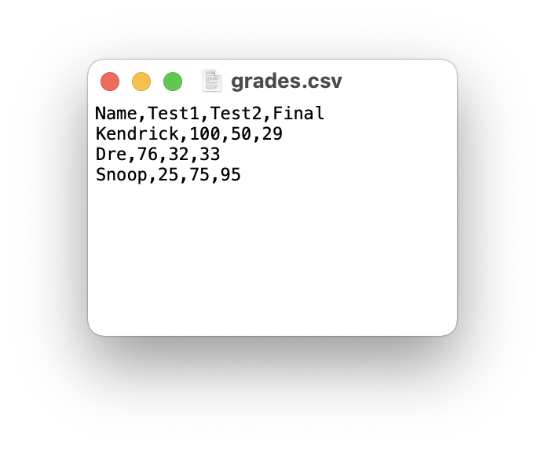
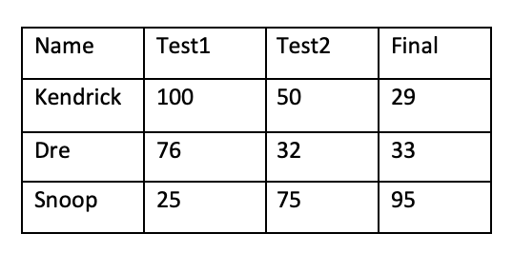
CSV Files
Text data is commonly organized in a spreadsheet format using columns and rows.
A common way to do this is to use a comma-separated value (CSV) file format that uses commas to separate data items, called fields.

Slide 15
Example: Opening a CSV File
Let’s see what happens when we try to read the CSV file, 'grades.csv' using the file reading techniques discussed earlier.
How can we use this to obtain column and row information?
with open('grades.csv', 'r') as file:
contents = file.read()
>>> contents
'Name,Test1,Test2,Final\nKendrick,100,50,29\nDre,76,32,33\nSnoop,25,75,95\n'

Slide 16

Reading CSV Files
The CSV module is a powerful solution developed for working with CSV files.
Reading of CSV files is done using the CSV reader. You can construct a reader object using csv.reader() which takes the file object as input.
The reader object can be used to iterate through the contents of the CSV file, similarly to how a file object was used to iterate through the contents in a text file.

Slide 17
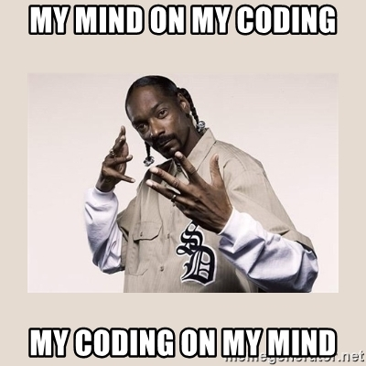
Example: Reading a CSV File (open/close)
Read each row of a CSV file using open/close
import csv
myfile = open("grades.csv", "r")
grades_reader = csv.reader(myfile)
row_num = 1
for row in grades_reader:
print('Row #', row_num, ':', row)
row_num += 1
csvfile.close()
Row # 1 : ['Name', 'Test1', 'Test2', 'Final']
Row # 2 : [‘Kendrick', '100', '50', '29']
Row # 3 : [‘Dre', '76', '32', '33']
Row # 4 : [‘Snoop', '25', '75', '95']

Slide 18
Example: Reading a CSV File (with)
Read each row of a CSV file using with
import csv
with open('grades.csv', 'r') as myfile:
grades_reader = csv.reader(myfile)
row_num = 1
for row in grades_reader:
print('Row #', row_num, ':', row)
row_num += 1
Row # 1 : ['Name', 'Test1', 'Test2', 'Final']
Row # 2 : [‘Kendrick', '100', '50', '29']
Row # 3 : [‘Dre', '76', '32', '33']
Row # 4 : [‘Snoop', '25', '75', '95']

Slide 19
Writing CSV Files
To write to the file we would first need to create a CSV writer object, csv.writer(), which similar to how we made a, CSV reader object.
Once the CSV writer object is created, we can use the writerow() method to populate it with data.
The writerow()method can only write a single row to the file at a time.

Slide 20
Example: CSV Files
In the previous grade example there were a few marking errors on the final exam and both Kendrick and Dre should have received a higher grade. Update the grades using the CSV writerow()method.
import csv
grades = [['Name', 'Test1', 'Test2', 'Final'],
[‘Kendrick', '100', '50', '69'],
[‘Dre', '76', '32', '53'],
[‘Snoop', '25', '75', '95']]
with open('grades_new.csv', 'w') as myfile:
grades_writer = csv.writer(myfile)
for row in grades:
grades_writer.writerow(row)

Slide 21
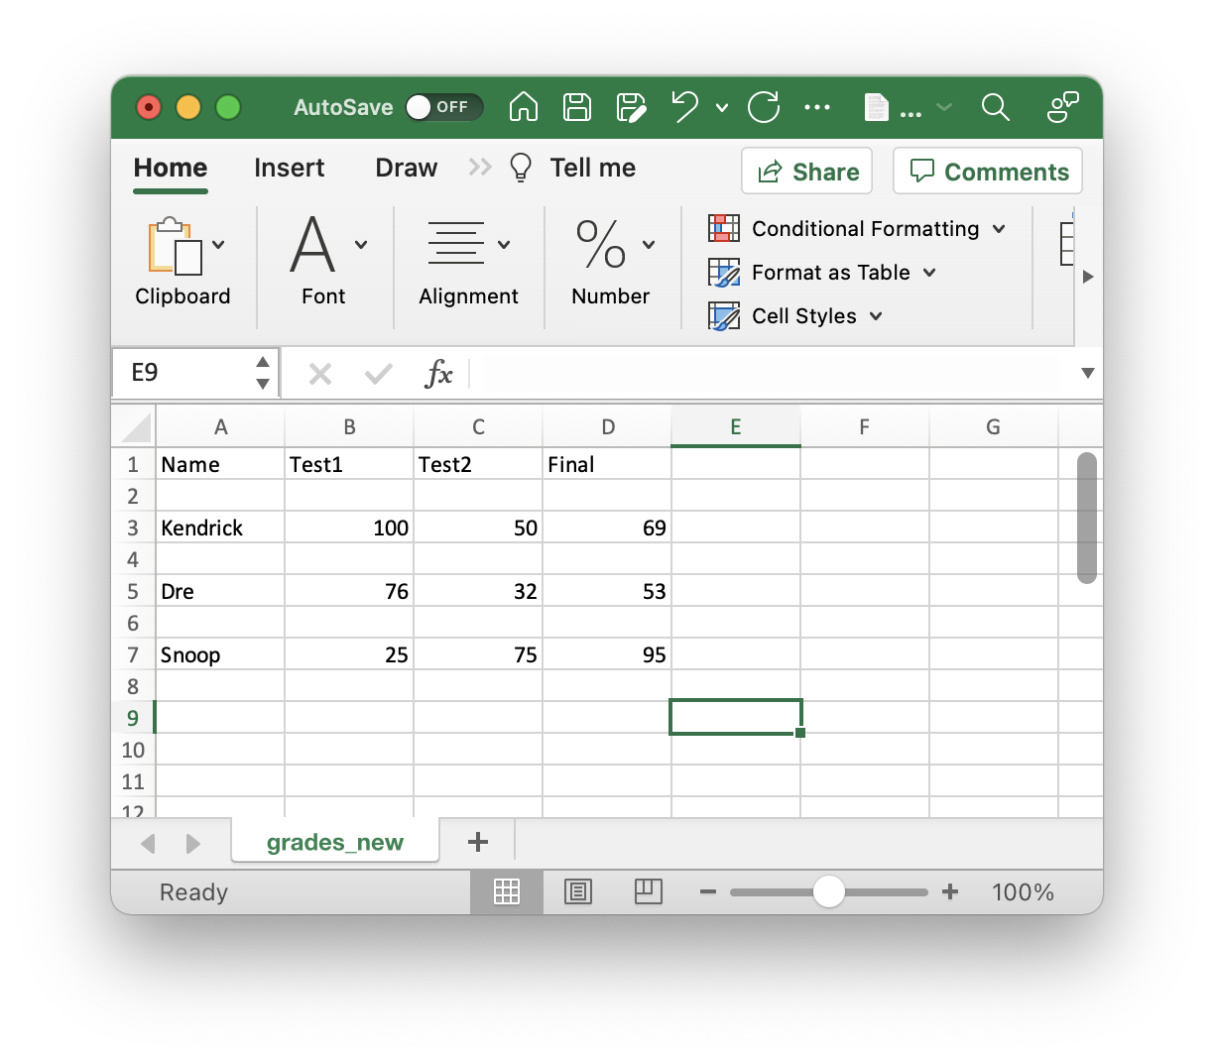
Opening CSV File in Excel
In the previous example we created a CSV file which can be opened in any commonly used spreadsheet software (e.g. Excel).
In some cases a formatting error may occur, probably due to the difference between newlines and carriage returns in Windows vs. Mac/Linux.
To correct this error in formatting, we will need to prevent the new line from forming. Add the parameter newline='', and that should resolve the problem.
with open('grades_new.csv', 'w', newline='') as csvfile:

Slide 22
Let’s Code!
Let’s take a look at how this works in Python!
Reading and Writing to CSV Files
Parsing through CSV Files
Modules
Open your notebook
Click Link:
4. CSV Files

Slide 23
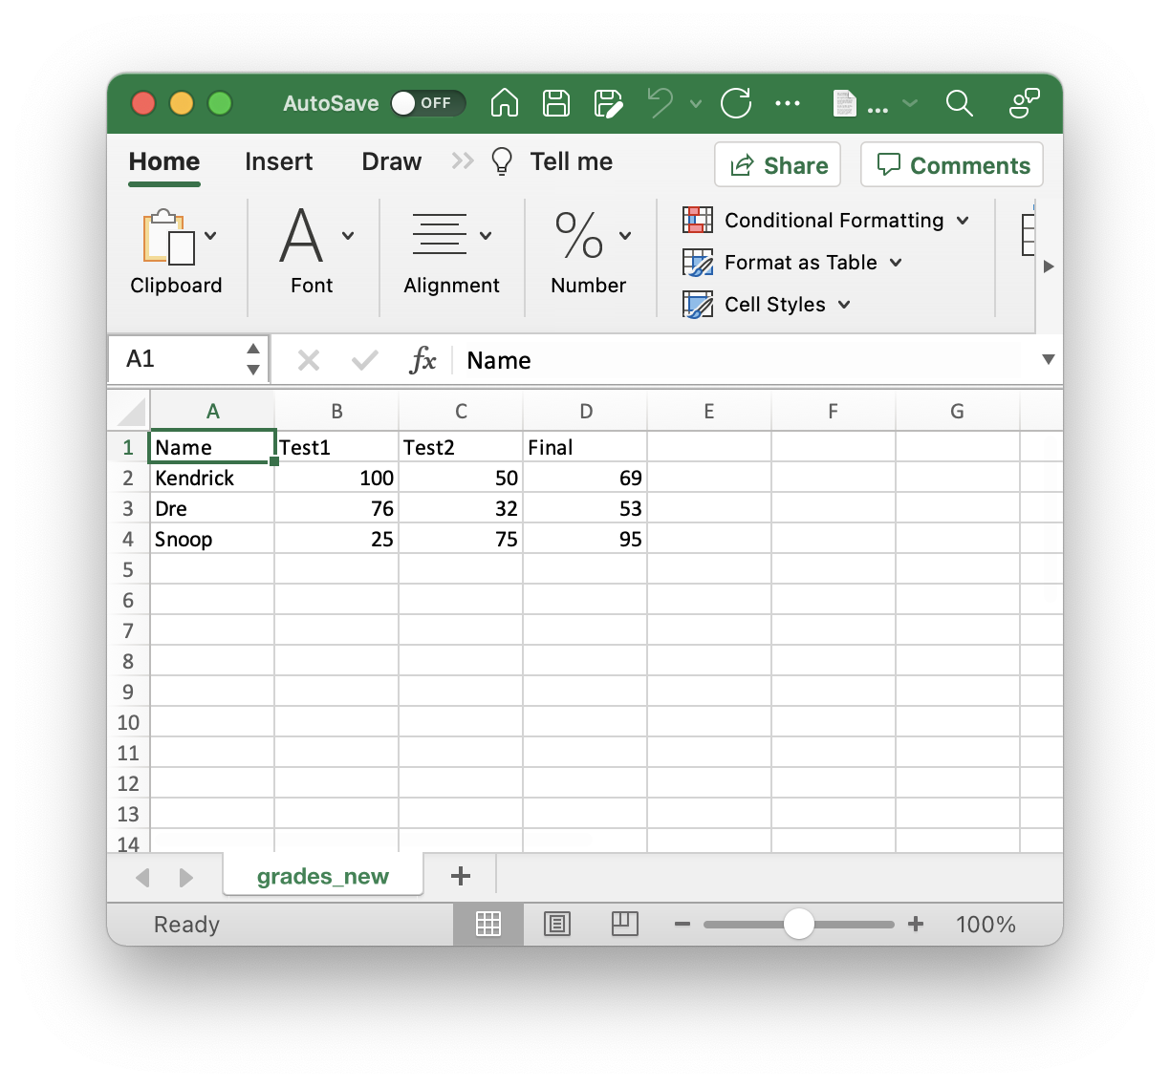
Summary: Reading Files
Requirement: “grades.csv”
##############################
reading a file using standard approach
##############################
# open communication to a file (to read)
myfile = open('grades.csv', 'r')
# read from file
L = myfile.readlines()
for row in L:
print(row, end = '')
myfile.close()
############################
reading a file using CSV Module
############################
import csv
# open communication to a file (to read)
myfile = open('grades.csv', 'r')
# read from file
csv_reader = csv.reader(myfile)
for row in csv_reader:
print(row)
myfile.close()
Requires find() method to obtain data!

Slide 24
Summary: Writing Files
Requirement: grades needs to be defined
grades = [['Name', 'Test1', 'Test2', 'Final'],
[‘Kendrick', '100', '50', '69'],
[‘Dre', '76', '32', '53'],
[‘Snoop', '25', '75', '95']]
#################################
#writing to a file using standard approach
#################################
# open communication to a file (to write)
myfile = open('new_grades.csv', 'w')
# write to file
for row in grades:
for col in row:
myfile.write(col + ',')
myfile.write('\n')
myfile.close()
#############################
#writing to a file using CSV Module
#############################
import csv
# open communication to a file (to write)
myfile = open('new_grades.csv', 'w')
# write to file
grades_writer = csv.writer(myfile)
for row in grades:
grades_writer.writerow(row)
myfile.close()

Slide 25
Modules

Slide 26
Importing Modules

Slide 27
Build Your Own Modules

Slide 28
Advanced Files: CSVs and Modules
Week 6 | Lecture 2 (6.2.2)

